Slide 1


Fundamentals of RM
RM System and Process
Leadership in RM
Incident Investigation
RM Tools & Challenges
RM in Industry
People & Org.
Application and Perspectives
On Becoming a
Leader in Risk Management
ENGG404 - Lecture
Case 4: Lithium ion Battery Fires in Electric Vehicles

Slide 2
Learning Outcomes
Explain the technical safety aspects of lithium ion battery fires and why they are considered a low frequency, high consequence risk scenario
Describe the bow tie approach for depicting key concepts in risk management
Apply the prevention through design (PTD) concept for the future of electric vehicle batteries
Case 4: Lithium Ion Battery Fires in Electric Vehicles
2
Notes:
2

Slide 3
Introduction
Superior attributes of Lithium ion battery
Higher current, voltage, power and energy density
Reduced cost, weight and pollution
Lack of memory effect
Excellent stability
Low self-discharge rate
Prolonged life cycle
Used in a variety of applications
Small cells in consumer electronics
Large scale packs in the electrification of road transport and smart grids
Managing peaks and valleys associated with output from wind and solar
Case 4: Lithium Ion Battery Fires in Electric Vehicles
3
Notes:
3

Slide 4
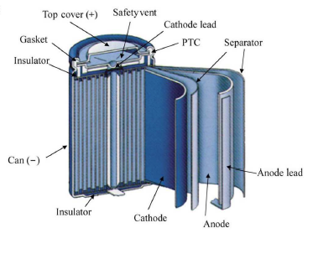
Battery Design
Cells produce an electric current by converting chemical energy into electrical energy
Two electrodes
  Negative (anode) - typically made of carbon (graphite)
  Positive (cathode) - generally consists of layers of lithium and metal oxide
Permeable barrier between the electrodes prevents internal short-circuiting
Electrolyte transfers charged ions between the electrodes. It consists of a lithium salt dissolved in an organic solvent, mainly carbonates.
Energy is related to the chemistry and construction of the LIB cell
Case 4: Lithium Ion Battery Fires in Electric Vehicles
4
Notes:
4

Slide 5
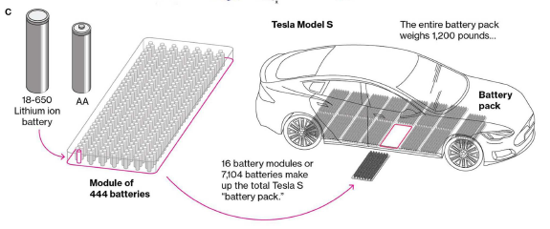
Multi-cell Pack for Tesla Model S:
Case 4: Lithium Ion Battery Fires in Electric Vehicles
5
Notes:
5

Slide 6
LIB Fires
Overview
Volatile organic electrolyte solution (hazardous)
Short circuit or high operating temp. can lead to exothermic reactions
Worst case scenario - battery catches fire or explodes (low frequency)
Different fire in terms of initiation, spread, duration, toxicity & suppression
Increase in fire risk is proportional to the increase in the mass and capacity of the battery (the fuel)
Last two decades
Variety of fires (small consumer electronics to large power systems)
Initial concerns with portable devices (cell phones and laptops)
Sony (2006) recalled 9.6 million notebooks with LIBs ($400 million)
Samsung (2016) recalled 2.5 million Note 7 smartphones ($17bn)
Boeing 787 Dreamliner grounding in 2013 (1.1 million USD/day loss)
Variety of electric vehicle fires including Chevy Volt and Tesla Model S
Case 4: Lithium Ion Battery Fires in Electric Vehicles
6
Notes:
6

Slide 7
Thermal Runaway
EV battery packs = composed of thousands of single cells
A thermal runaway (TR) can initiate in a single cell and propagates to other cells in the pack
LIB temp. reaches a critical value such that the reaction rate of an exothermic reaction increases the temp. & accelerates the reaction rate
A fast process that occurs at a time scale <2 s, leading in most cases to battery rupture in less <0.01 s
Triggers for LIB TR
  External abuse (mechanical, thermal, electrical)
  Internal failure (defects, self-heating)
  Critical for LIB to balance heat generation with heat dissipation
Case 4: Lithium Ion Battery Fires in Electric Vehicles
7
Notes:
7

Slide 8
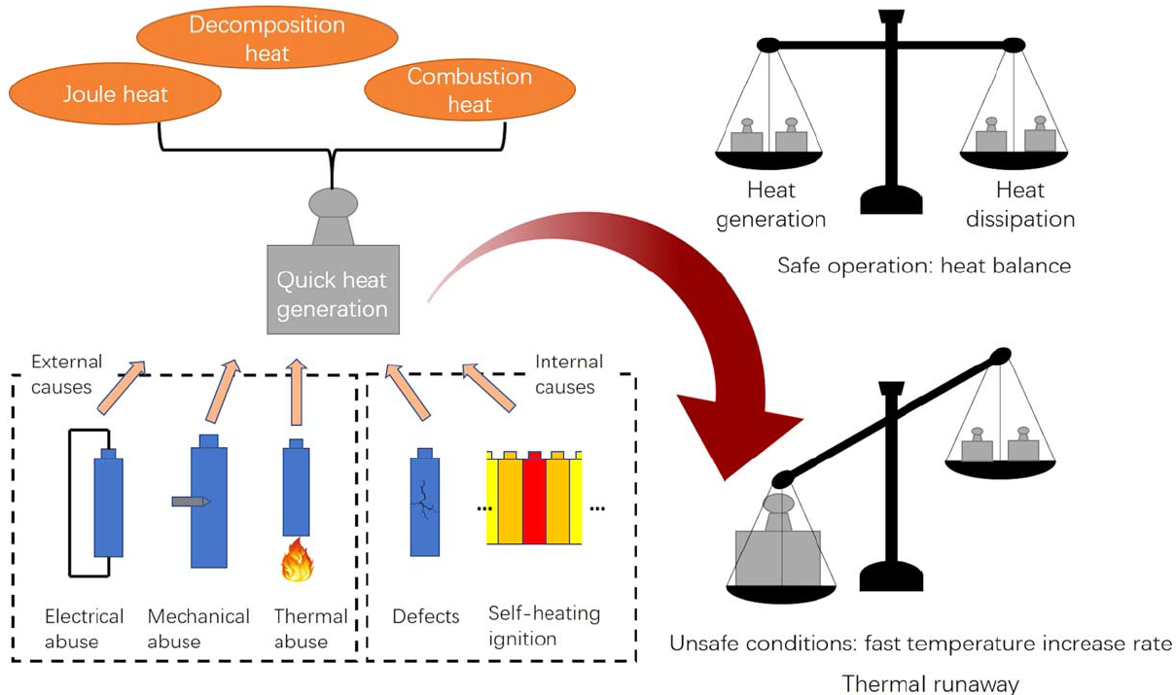
LIB TR & Imbalance Between Heat Generation & Dissipation:
Case 4: Lithium Ion Battery Fires in Electric Vehicles
8
Notes:
8

Slide 9
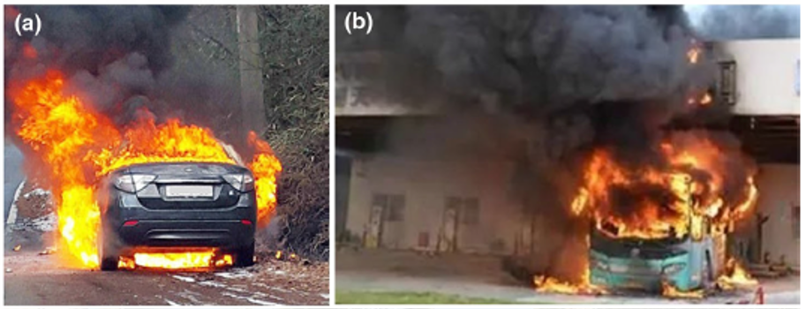
Electric Vehicle LIB related Fires
a) A Renault-Samsung EV caught fire while driving (January 2016, Korea)
b) A pure battery electric bus caught fire in a charging station (April 2015, Shenzhen, China)
Case 4: Lithium Ion Battery Fires in Electric Vehicles
9
Notes:
9
9

Slide 10
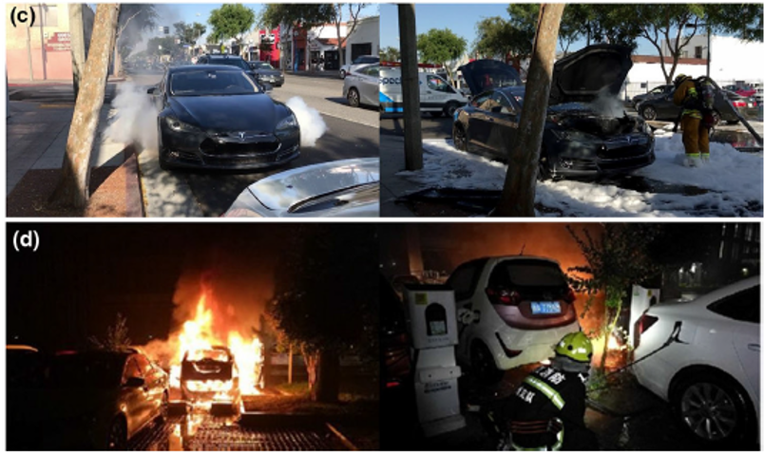
Electric Vehicle LIB related Fires
c) A Tesla Model S released smokes while being driven (June 2018, California)
d) EV fire in a parking lot (May 2018, Hangzhou, China)
Case 4: Lithium Ion Battery Fires in Electric Vehicles
10
Notes:
10
10

Slide 11
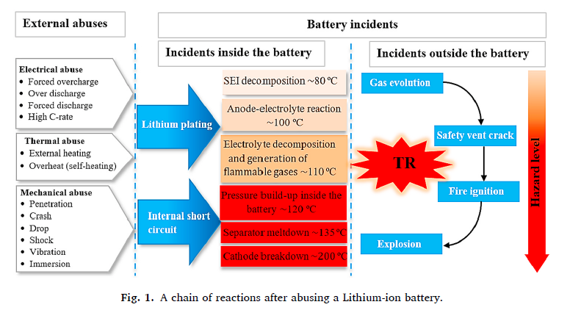
Chain of Events after abusing a LIB
Case 4: Lithium Ion Battery Fires in Electric Vehicles
11
Notes:
11

Slide 12
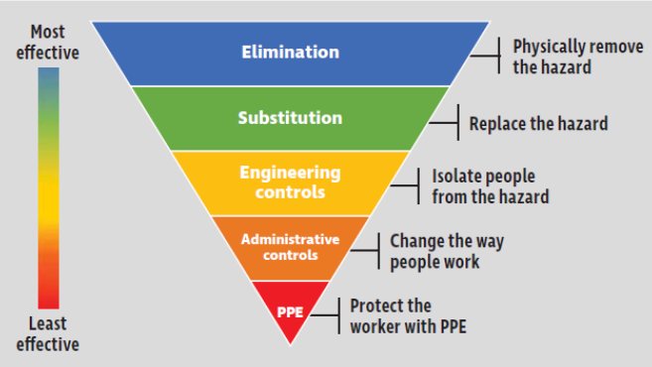
Prevention Through Design
  Preventing battery failure which sometimes lead to thermal runaway reactions & fires has remained a challenge for LIBs
  Recall PTD focus is to “engineer out the hazards” through our designs
  PTD focus area is battery chemistry and design to prevent TR fires
  PTD with inherently safer materials:
    Cathode chemistry
    Modified separators
    Modified electrolytes
    Solid state batteries
Case 4: Lithium Ion Battery Fires in Electric Vehicles
12
Notes:
12

Slide 13
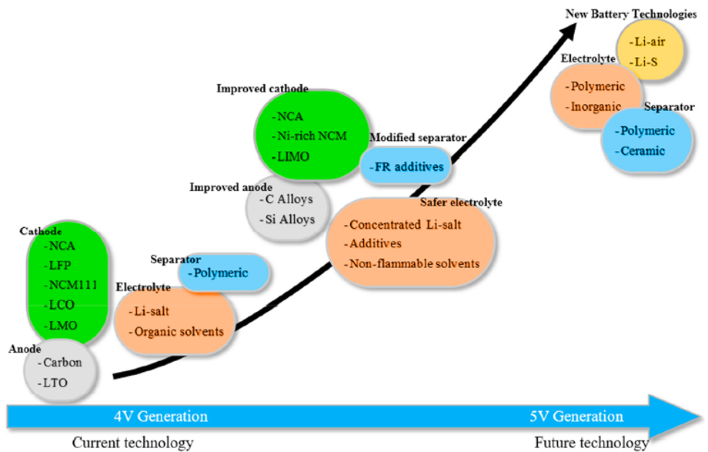
Potential PTD Opportunities for LIBs
Case 4: Lithium Ion Battery Fires in Electric Vehicles
13
Notes:
13

Slide 14
Summary & Key Lessons
LIB technology is superior but the current designs have the risk of a low frequency, high consequence risk event (fires to thermal runaway)
A variety of LIB-related fires have occurred over the last two decades
A bow tie diagram provides a simple visual depiction of a complex situation (especially when dealing with non-specialists)
Prevention through design opportunities are in the area of inherently safer design that reduce the frequency of LIB-related fires
Case 4: Lithium Ion Battery Fires in Electric Vehicles
14
Notes:
14

Slide 15
Any questions?
Notes:
15

